Slide 1


Slide 2
Guided By :-
Dr. Sudheep Elayidom
Professor
Division of Computer Science and Engineering
Group Members :-
Gurudatt Kumar(12170030)
Kumar Gaurav(12170039)
Manish kr. Chaudhary(12170041)

Slide 3
INTODUCTION
This project deals with the development and implementation of web application which helps job seekers to get trained and familiarized with recruitment process of different companies.
This application provides placement procedure, learning materials and practice exam.
It provides real time chat support through which job seekers can directly interact with alumni of different companies.
It also provides help community support and social media support.
The job seeker can come to the portal, learn, Test and prepare himself for different companies.

Slide 4
PROBLEMS WITH EXISTING SYSTEM
Job seeker need to manually enrol to some training centre to get trained for placement preparation. This type of centre take huge money form user as well as precious time.
There is no alumni support team to help students for their proper guidance.
There are some online platform present but they don’t cover every aspects of students.
There is no common platform which covers companies from every sectors.
Students are still in search of quality assured and cost effective platform.

Slide 5
PROPOSED SYSTEM
A solution to these issues is a web application which comprises of all the functionality where one can learn about recruitment process of different companies from different sectors, gets previously asked questions, practices questions and real time mock tests and a real time alumni chat support.

Slide 6
USERS OF THE SYSTEM
Job seeker :
Job seekers are the primary users of the placement portal.
Alumni :
Alumni are the supporting hand to the placement team who can
help job seekers to clear their doubt.
System Administrator :
They are primarily responsible for maintaining the portal.

Slide 7
TOOLS USED
Front-End :
HTML, CSS and Bootstrap.
Back-End :
Django python Framework.
Chat Support :
Dialog Flow.
Discussion Form :
Google Group.
Alumni Support :
PHP and XAMPP Server.
Placement Assistant Social Group :
Facebook Group.
Database :
PostgreSQL and MySQL.

Slide 8
WHY DJANGO?
Django is an open-source framework for backend web applications based on Python - one of the top web development languages. Its main goals are simplicity, flexibility, reliability, and scalability. Django has its own naming system for all functions and components (e.g. HTTP responses are called “views”). It also has an admin panel, which is deemed easier to work with than in Lavarel or Yii, and other technical features, including:
Simple syntax.
Its own web server.
MVC (Model-View-Controller) core architecture.
“Batteries included” (comes with all the essentials needed to solve solving common cases).
An ORM (Object Relational Mapper).
HTTP libraries.
Middleware support.
A Python unit test framework.

Slide 9
WHY BOOTSTRAP ?
Bootstrap is a framework to help you design websites faster and easier. It includes HTML and CSS based design templates for typography, forms, buttons, tables, navigation, modals, image carousels, etc. It also gives you support for JavaScript plugins.
Bootstrap's responsive CSS adjusts to phones, tablets, and desktops.
Mobile-first styles are part of the framework.
Bootstrap is compatible with all modern browsers (Chrome, Firefox, Internet Explorer, Safari, and Opera).
Bootstrap has a big community and friendly support.

Slide 10
PORTAL OVERVIEW
Home Page
Signup and Login
Companies.
IT and Software
Real Estate
Telecommunication
PSU
Auto and Ancillaries
Metal and Mining
Power
E-Commerce
Alumni Real Time Chat Support
Help Community
Social Media Support
Automated Chat Support
Take Test

Slide 11
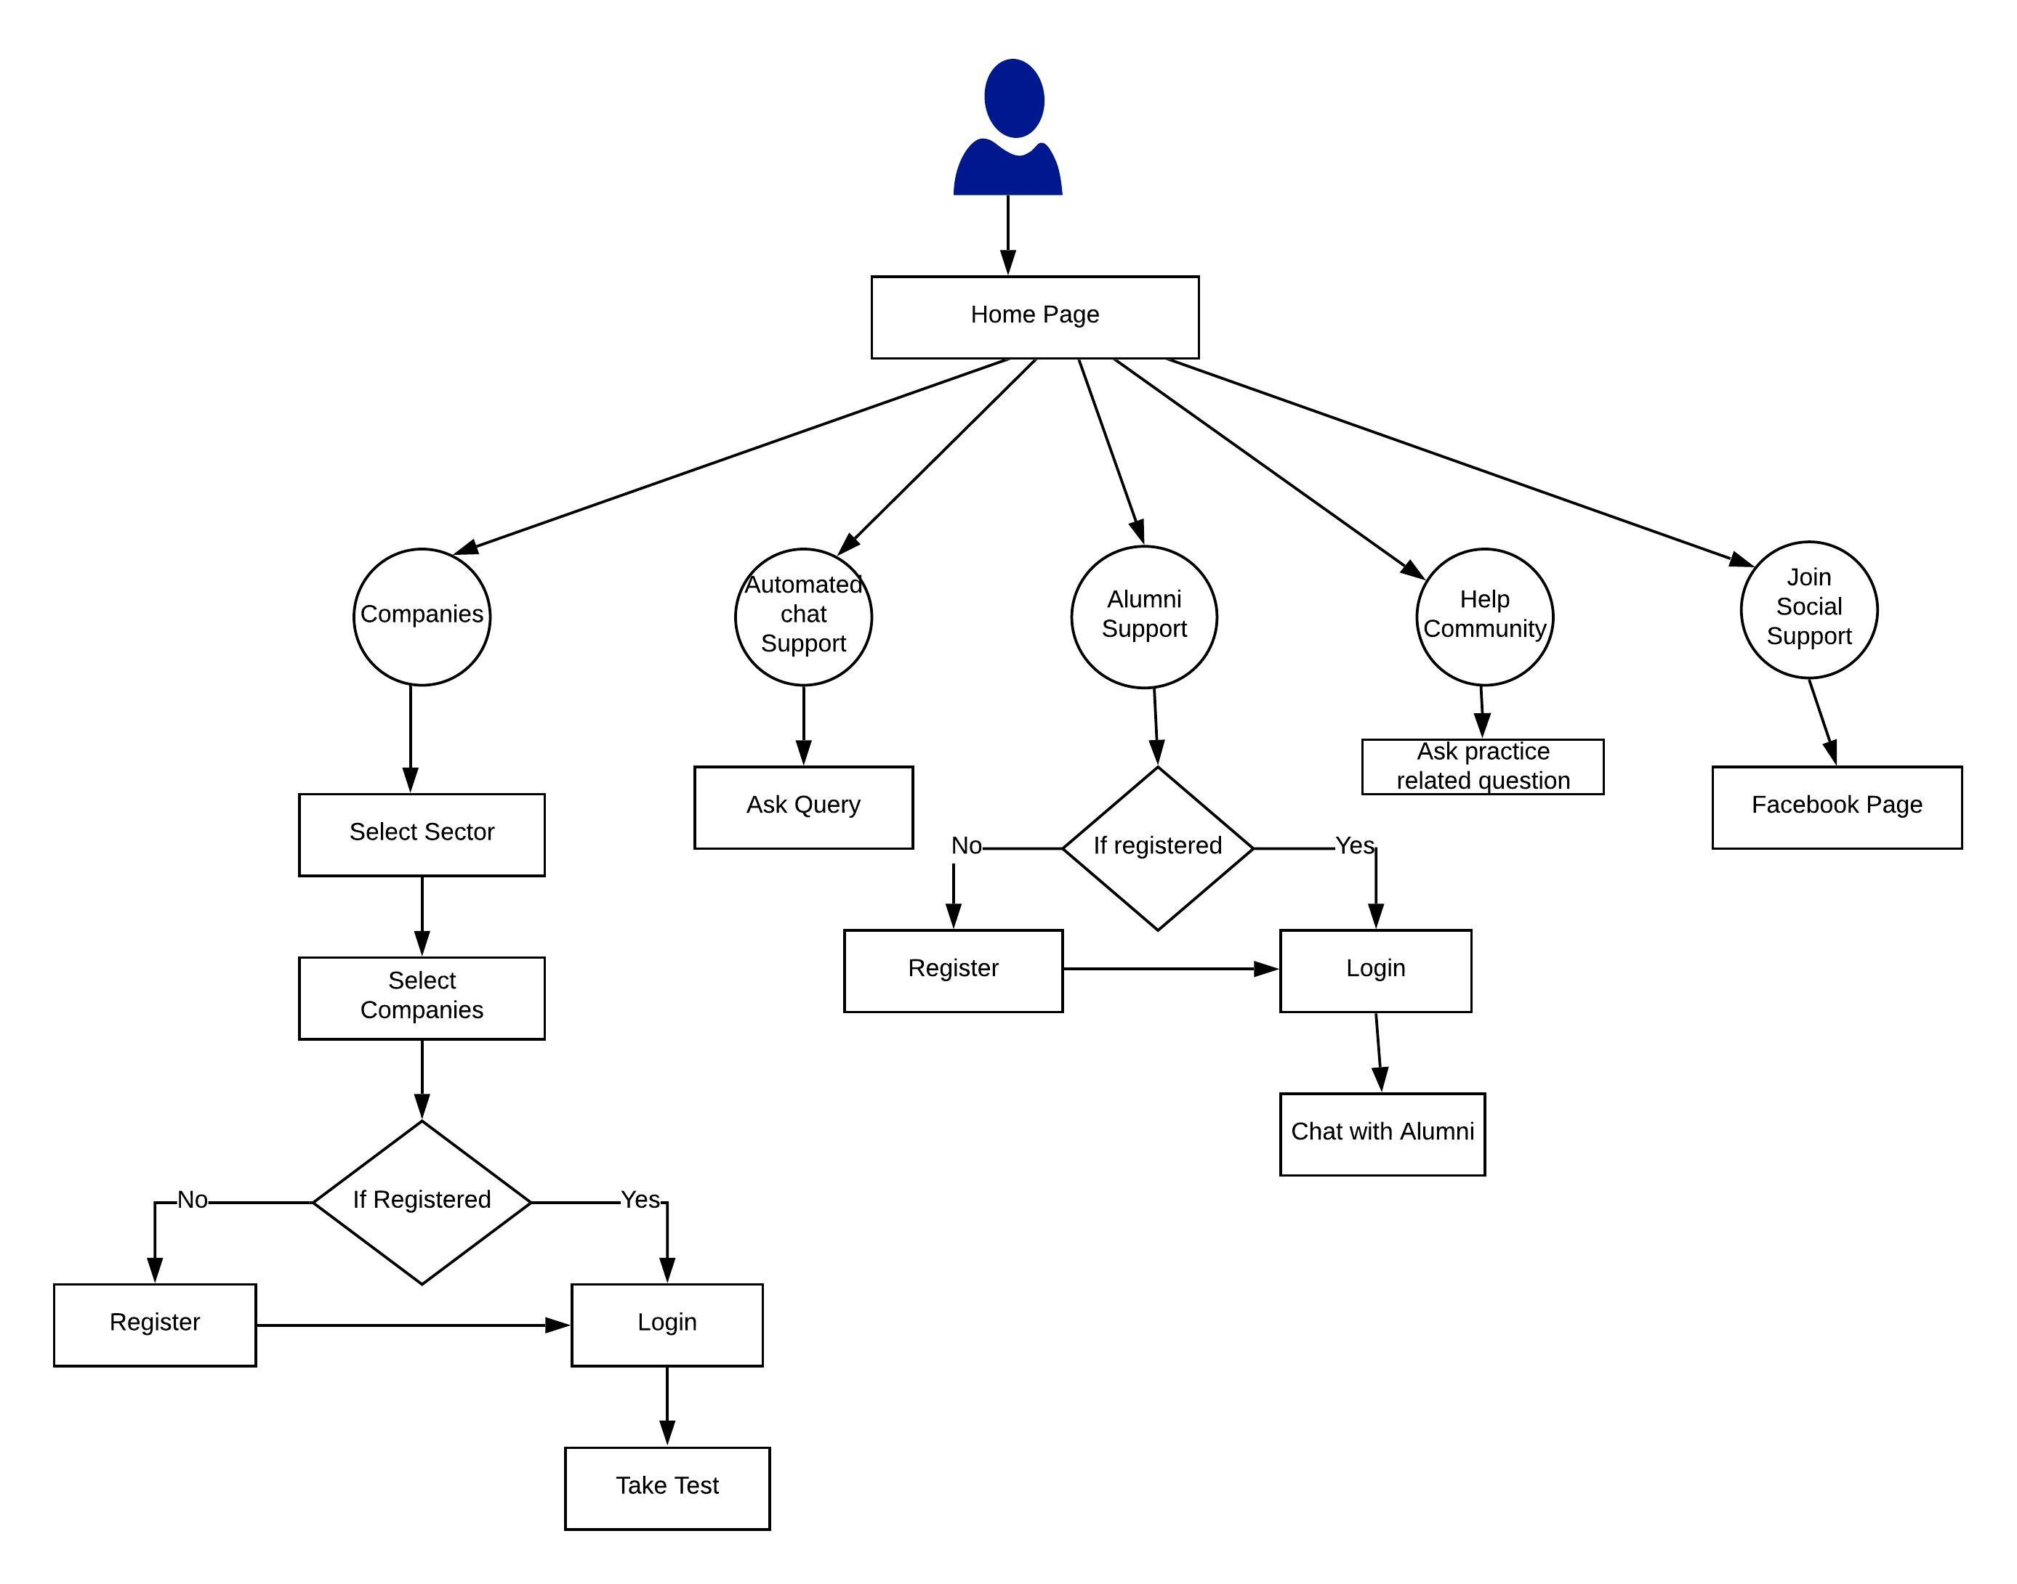
DATA FLOW DIAGRAM

Slide 12
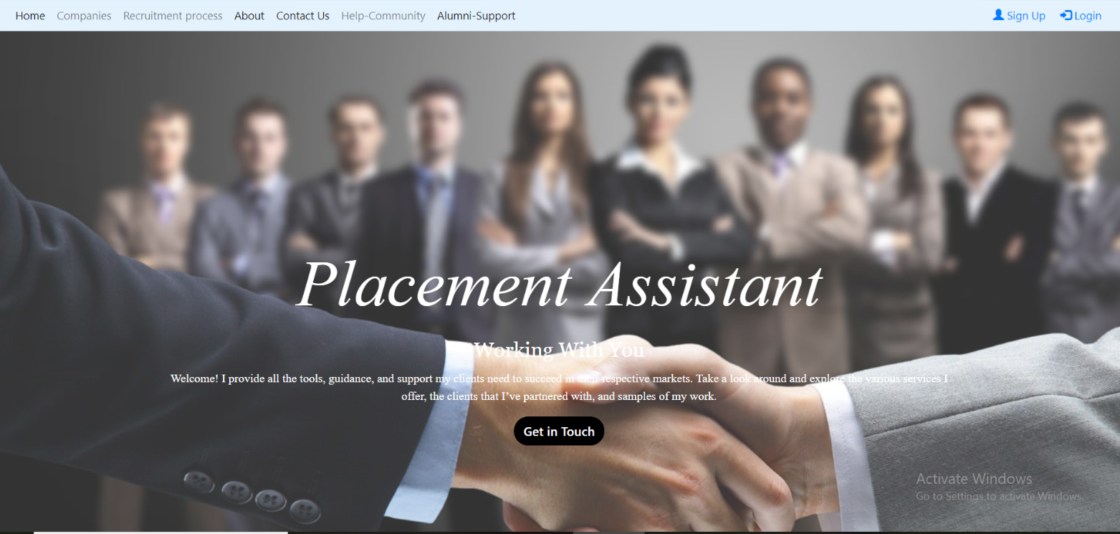
HOME PAGE

Slide 13
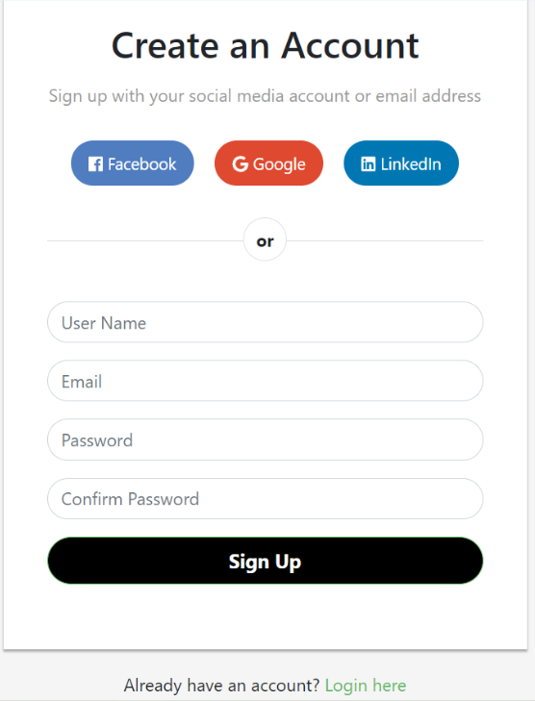
SIGNUP

Slide 14
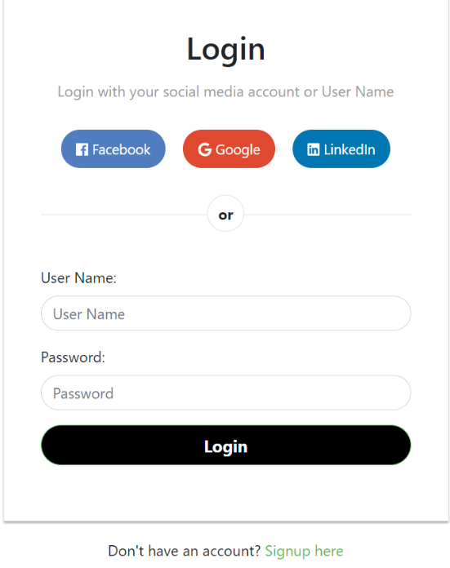
LOGIN

Slide 15
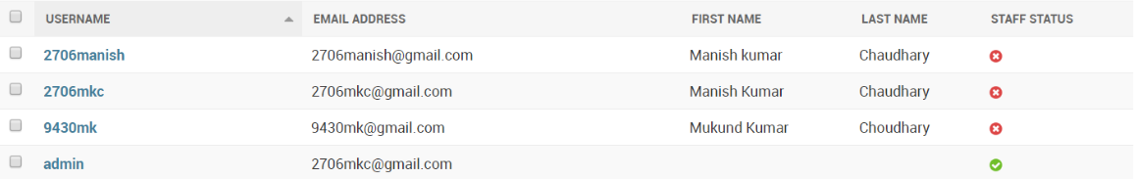
DATABASE

Slide 16
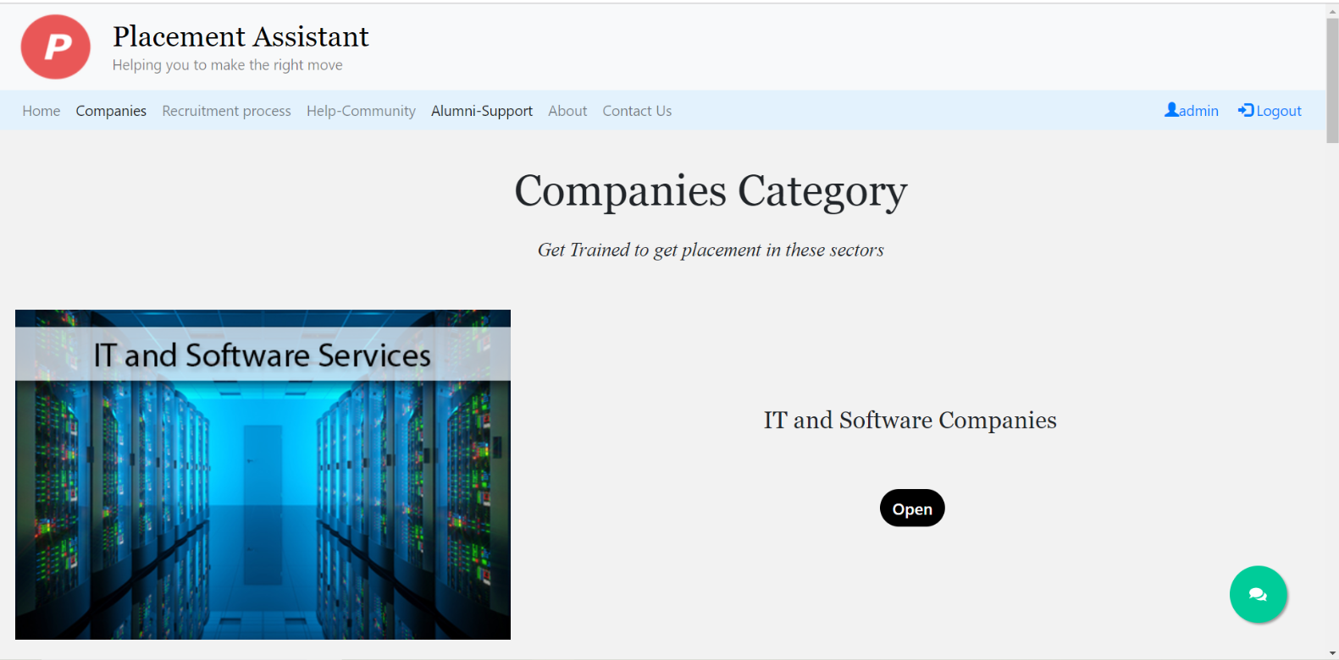
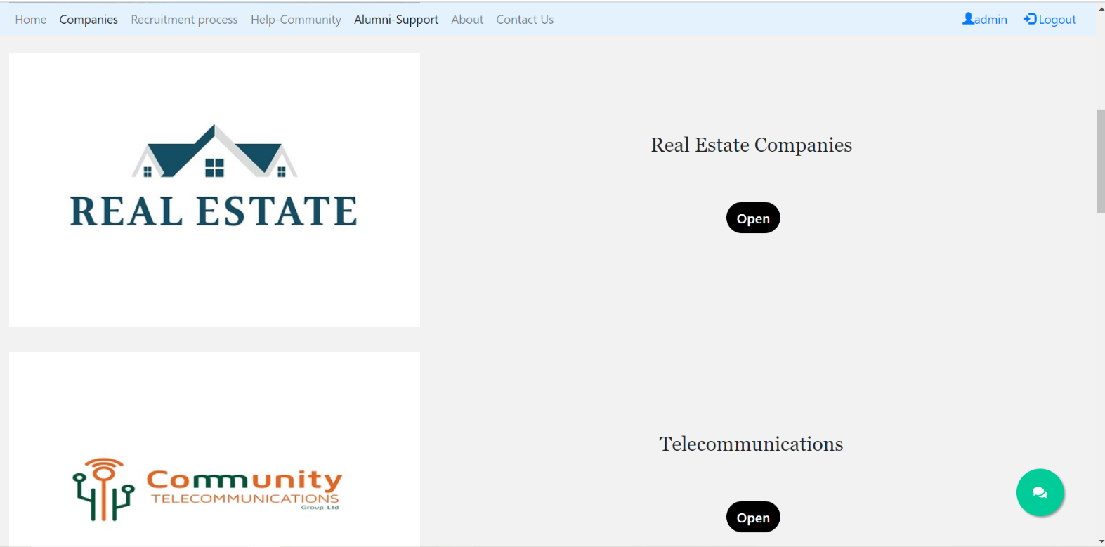
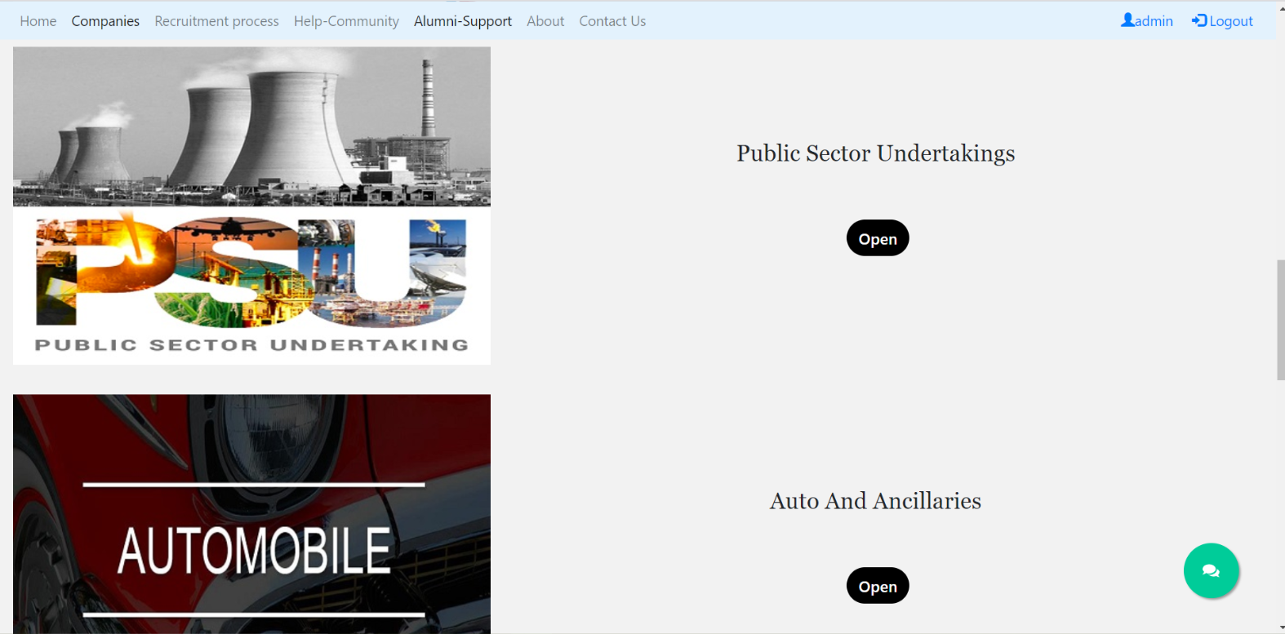
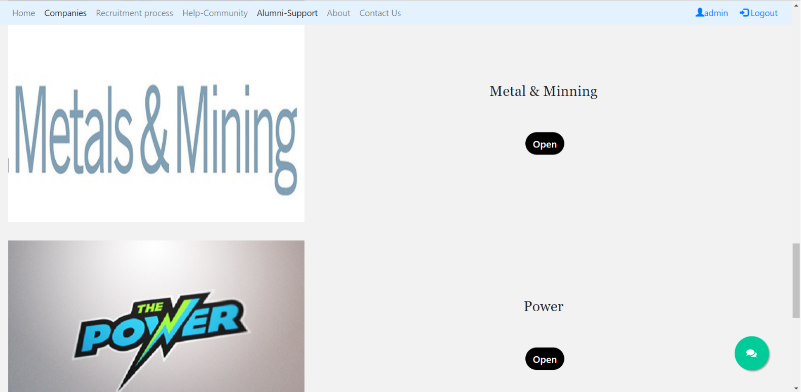
COMPANIES CATEGORY

Slide 17
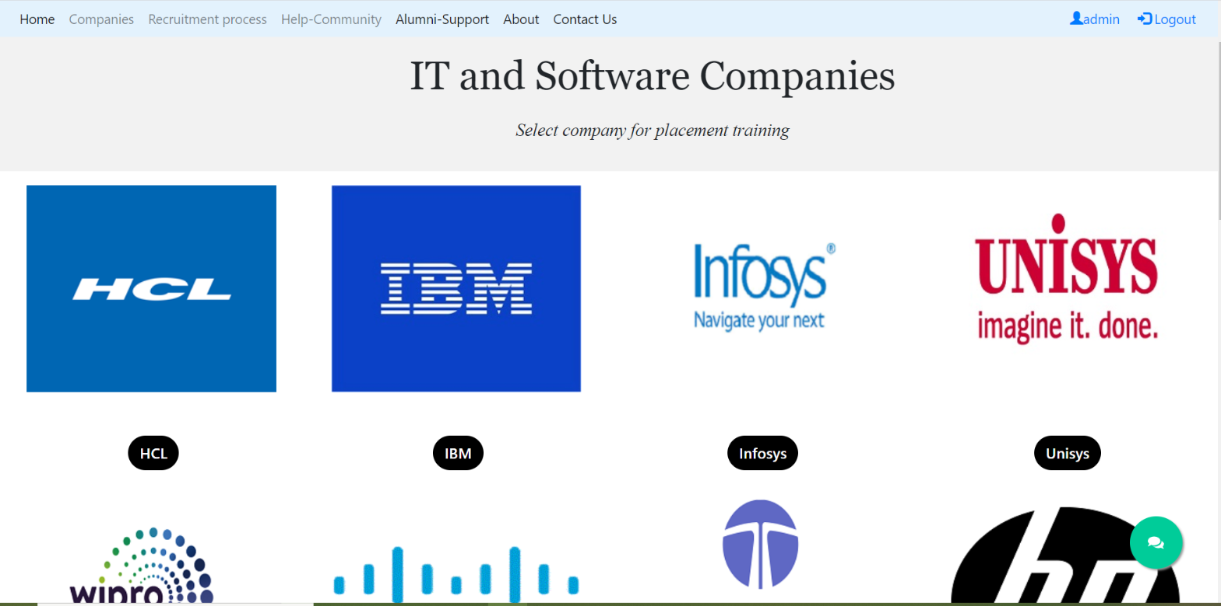
IT & SOFTWARE COMPANIES

Slide 18
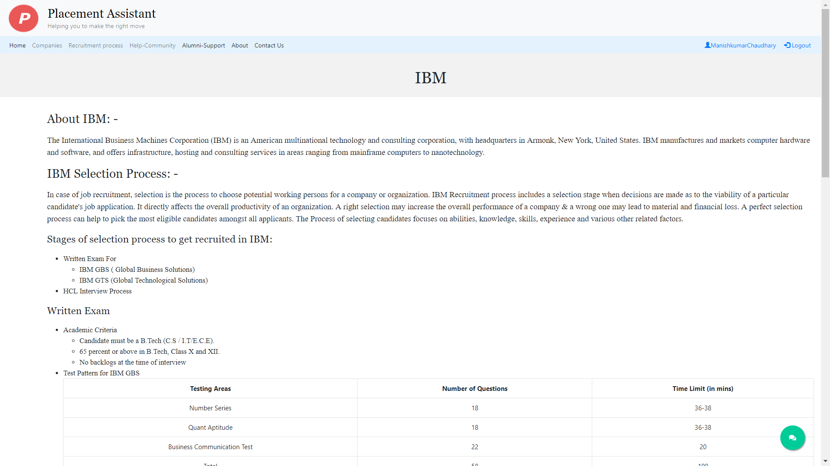
IBM

Slide 19
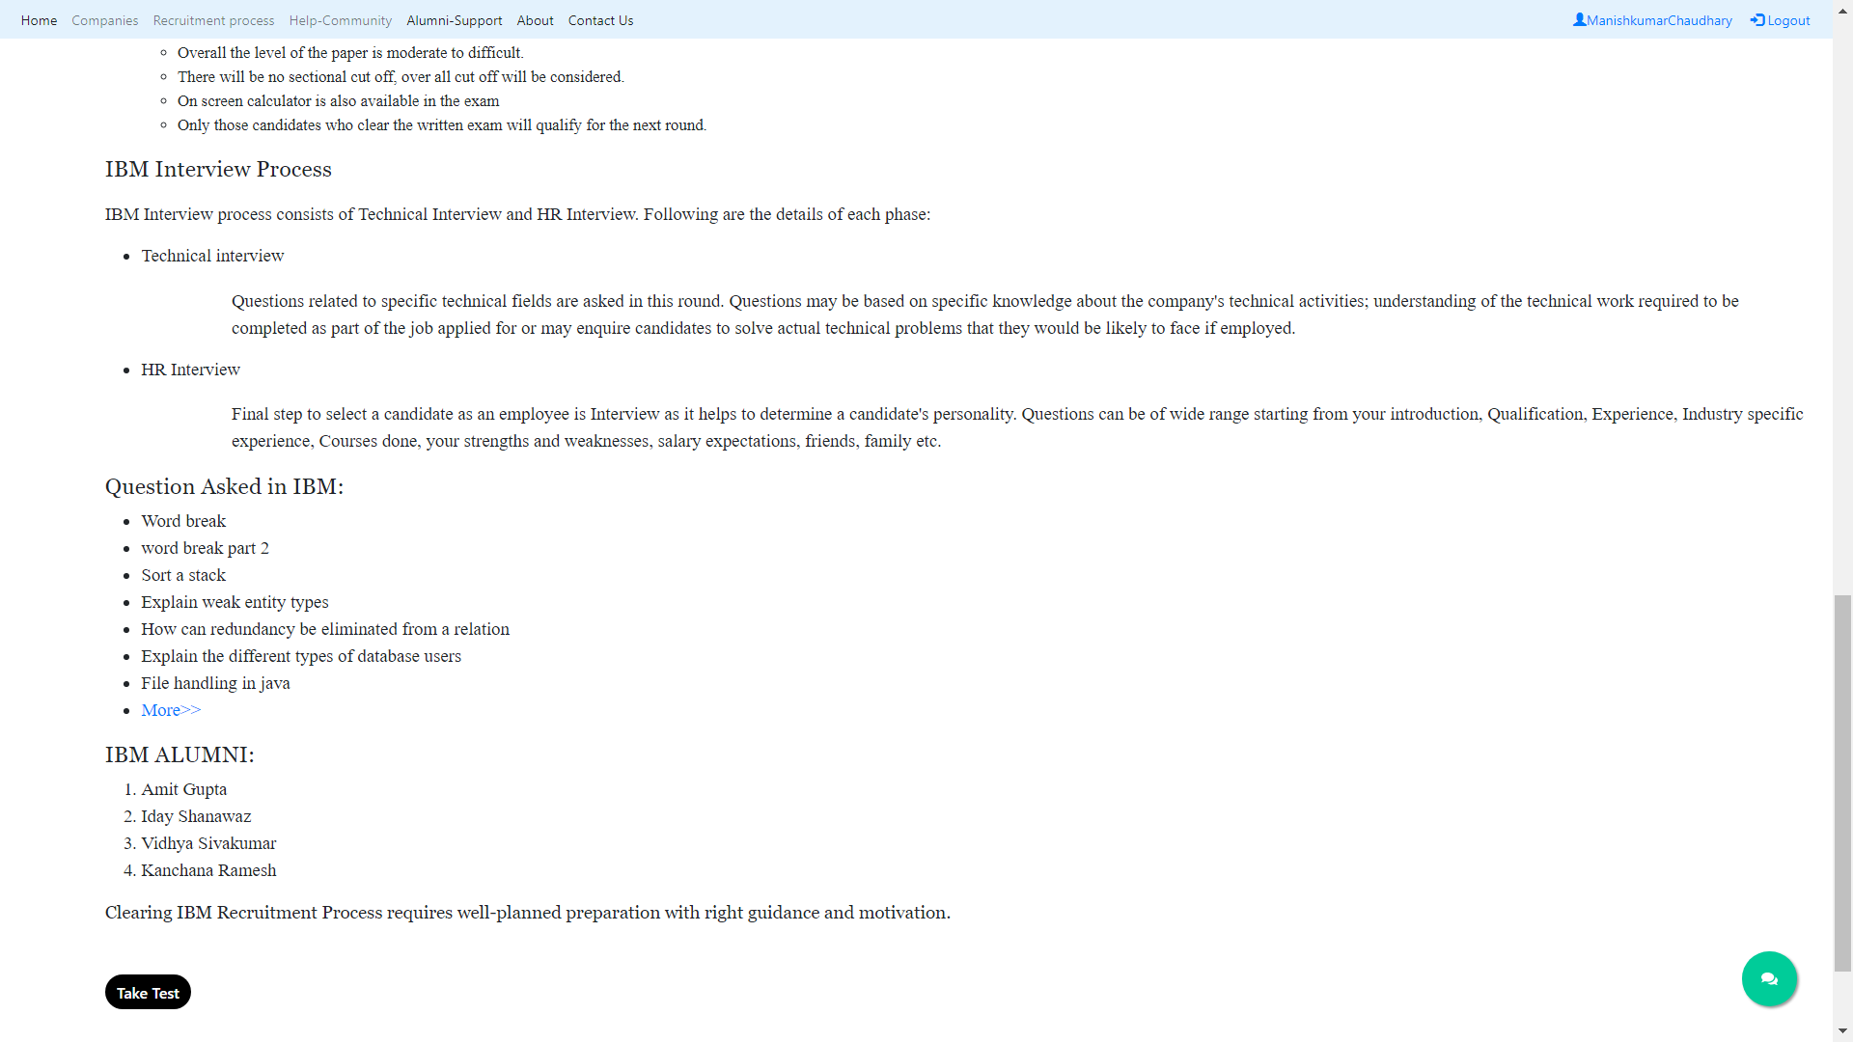

Slide 20
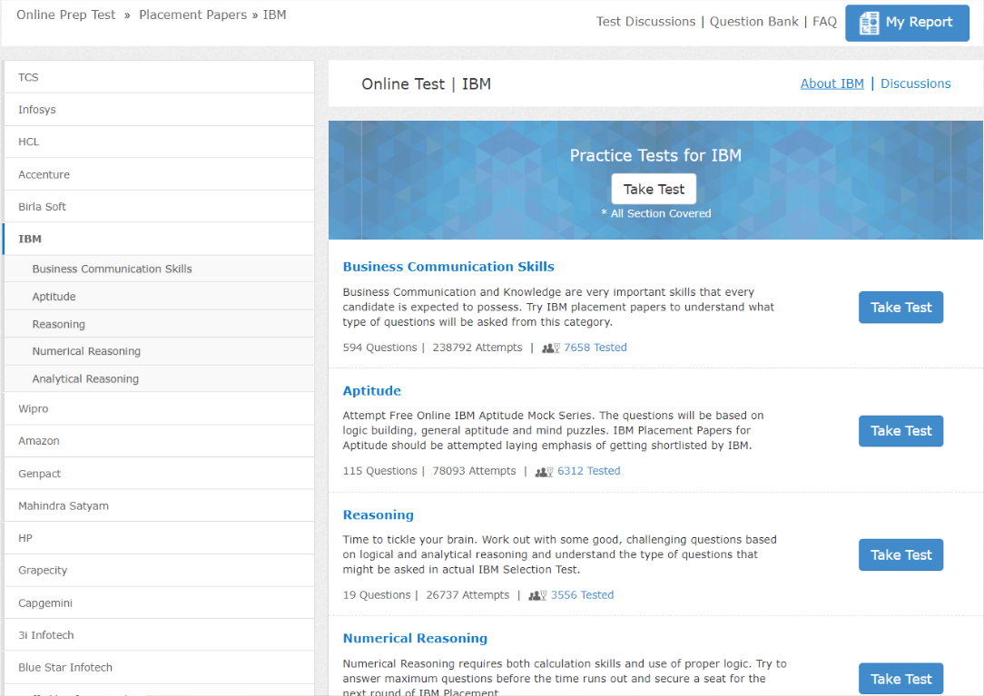
TAKE TEST

Slide 21
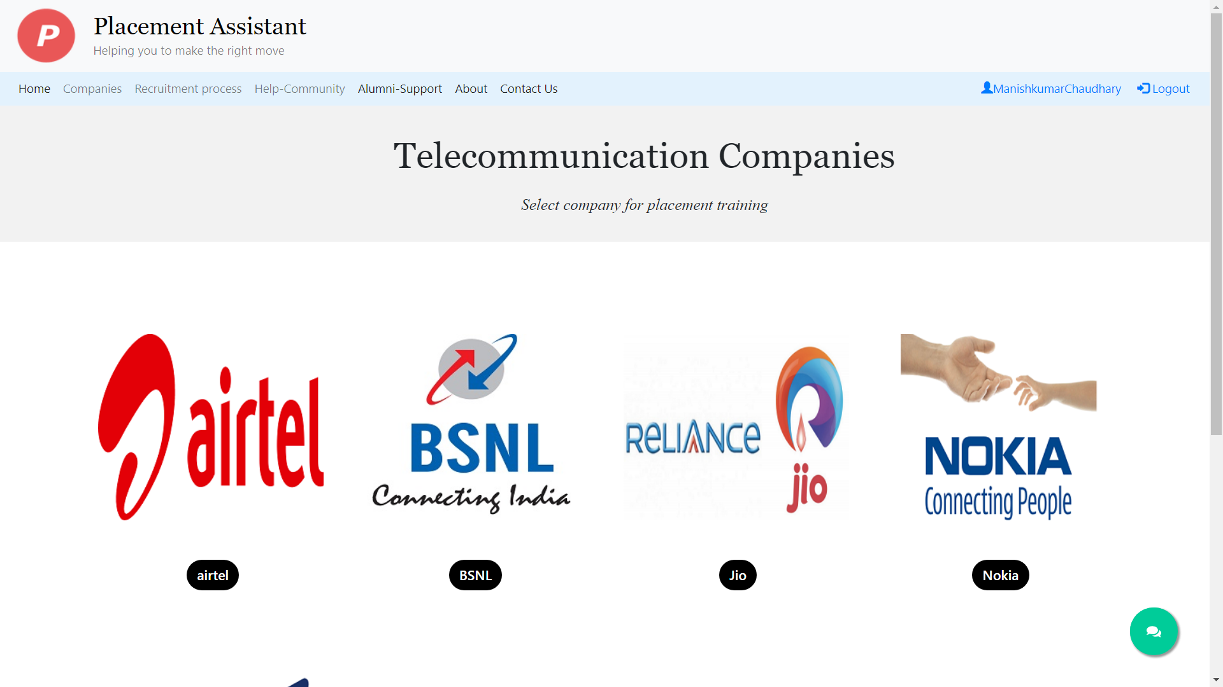
TELECOMMUNICATION

Slide 22
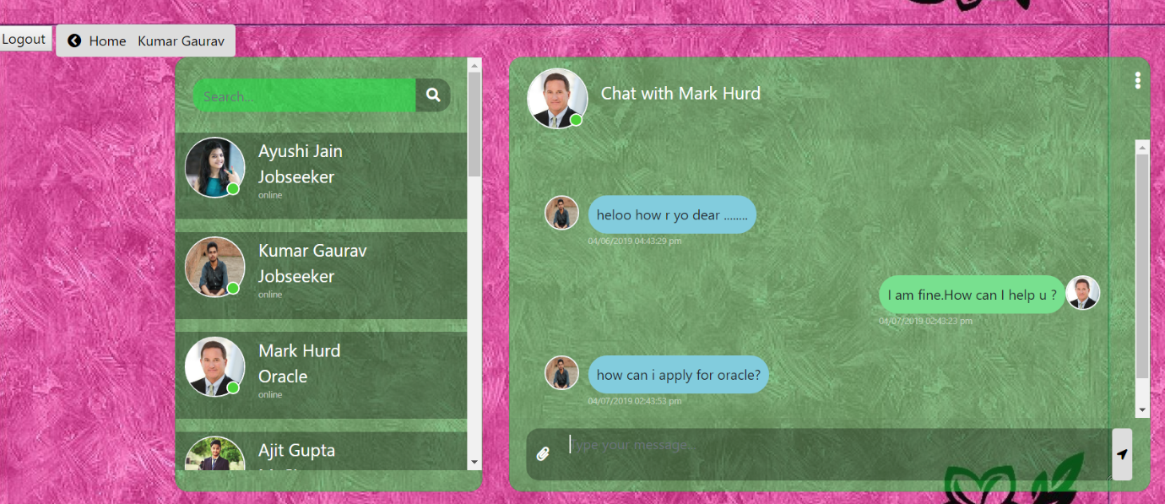
ALUMNI REAL TIME CHAT SUPPORT

Slide 23
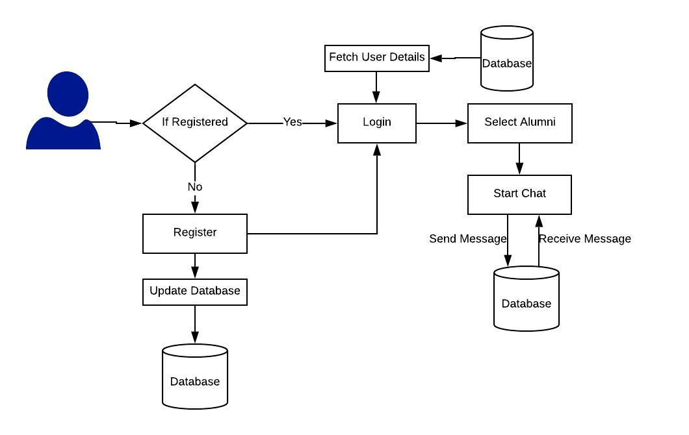
DATA FLOW DIAGRAM

Slide 24
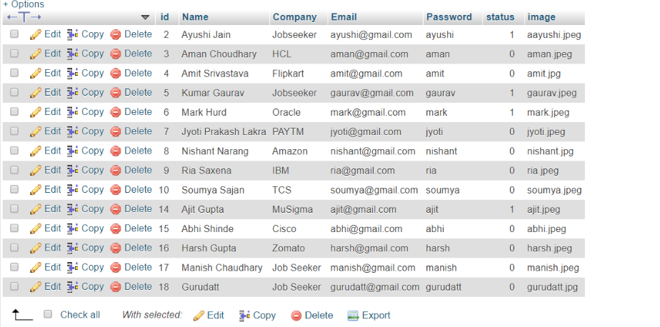
DATABASE

Slide 25
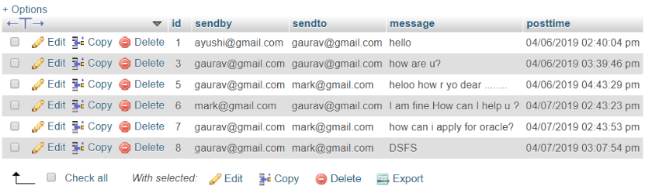
Cont.…

Slide 26
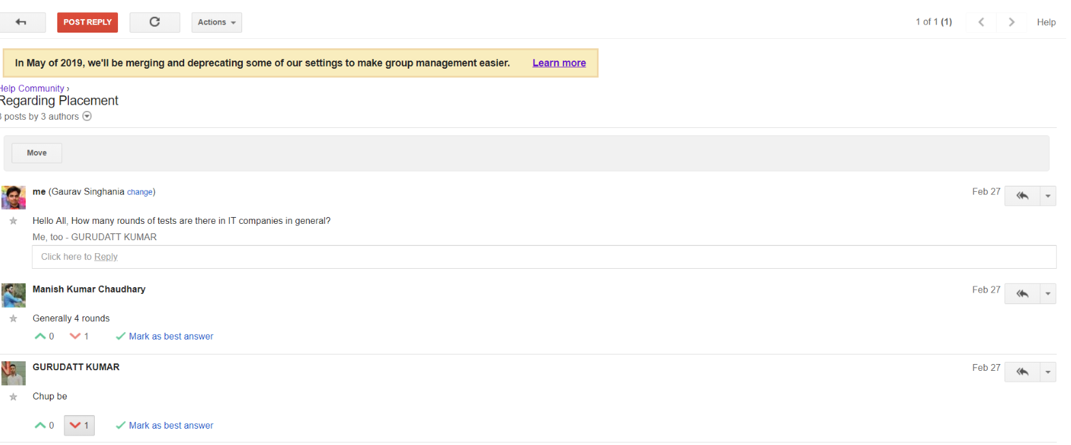
HELP COMMUNITY

Slide 27
PURPOSE
If a user get stuck during practice question, than they can directly ask to mentors and other users.
All other user and mentor get an email notification regarding the question.
Whoever has answer can replay to that question.

Slide 28
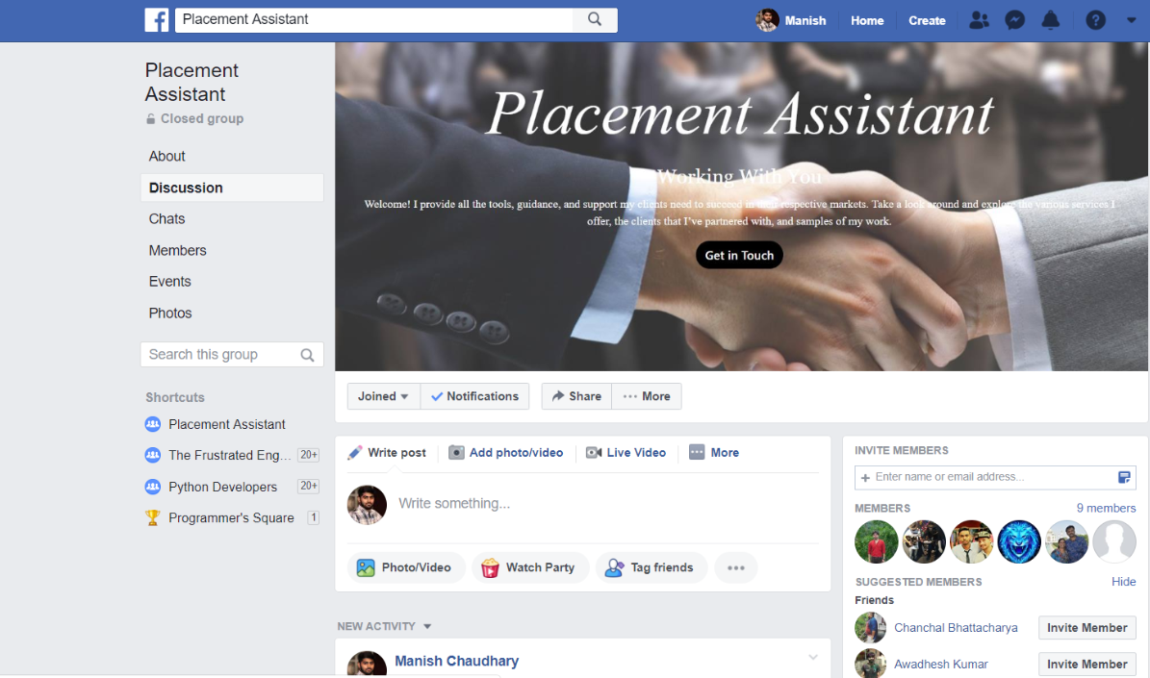
SOCIAL MEDIA SUPPORT

Slide 29
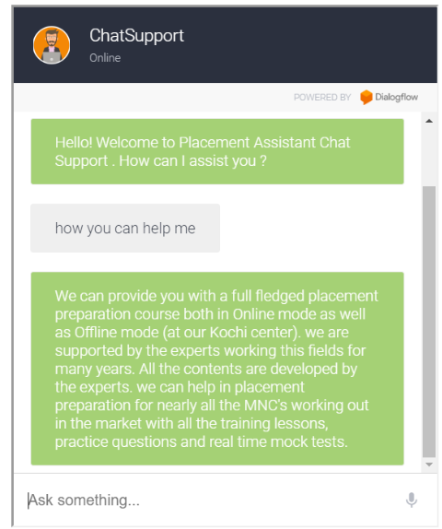
AUTOMATED CHAT SUPPORT

Slide 30
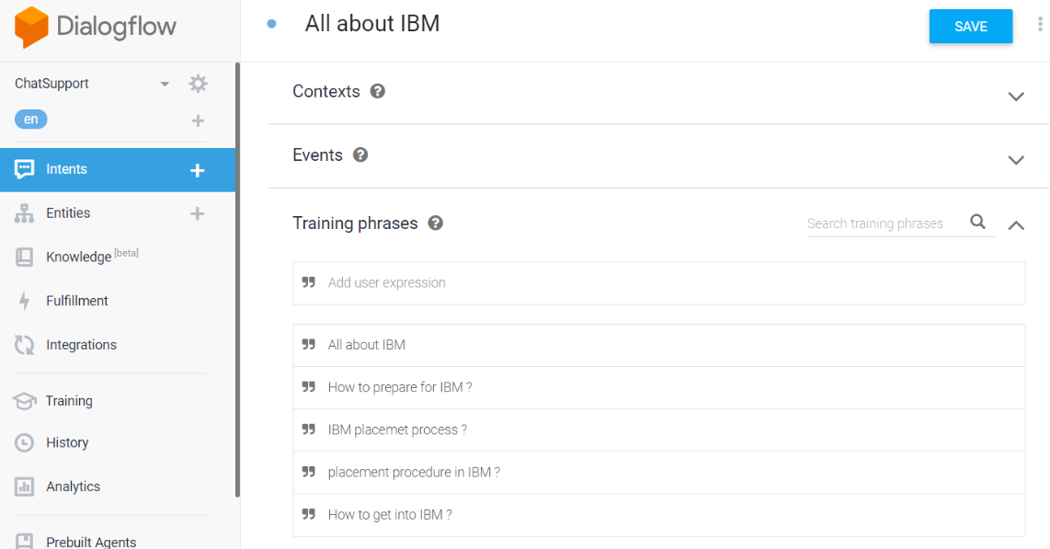
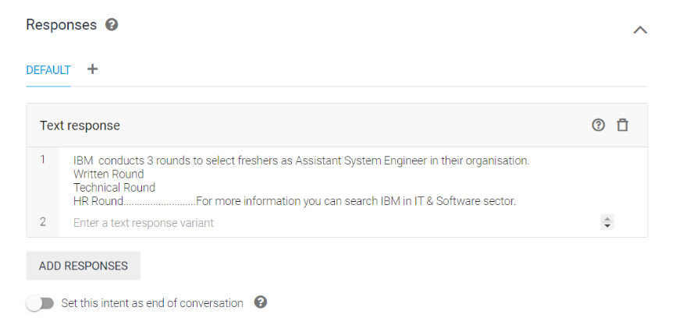
Back-End Work

Slide 31
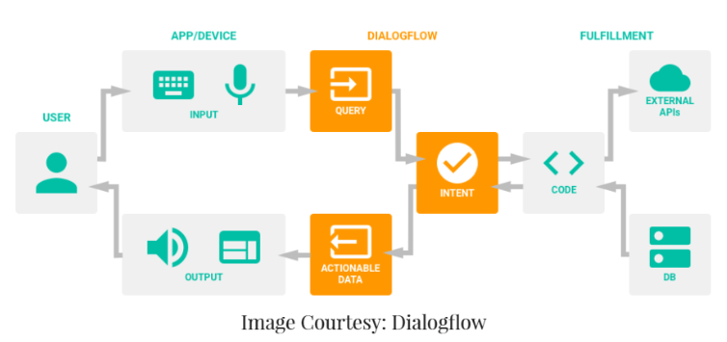
FLOW DIAGRAM

Slide 32
FUTURE SCOPE
Collaborate different MNCs and local companies on this portal which can share job openings in his company for different posts and complete learning and recruitment process.
To provide learning material and practice exam for different govt. level competitive exams like gate, cat, ssc etc.
Document evaluation like evaluation of resume, LORs, Cover Page, Profile Building etc.
To conduct competitive exams among its users across nation to get evaluate oneself where he/she stands.
Help in getting a confirmed internship.

Slide 33
CONCLUSION
Your career is just a click away.
It is basically a transition from manual job training centre to digital job training centre. Any user having an internet access can use this learning portal on any device like PC, Laptop, iPad and even smartphone.
The proposed application will be used by students for preparation of campus recruitment drive and by professional who want change their jobs and want a better opportunity in product based companies.
Our portal is quality assured, 24*7 live, cost effective platform to get trained.

Slide 34
REFERENCES
Web Links :
https://getbootstrap.com/docs/4.3/
https://www.geeksforgeeks.org/
https://www.w3schools.com/
https://www.freshersworld.com/
https://en.wikibooks.org/wiki/LaTeX
Books :
Rajib Mal, Fundamental of Software Engg., 2nd Edition
IEEE 830-1998 standard for writing SRS Document
Learning python, Mark Lutz, Oreilly, 2010
Django 2 Web Development, Cookbook, Jake Kronika, 3rd Edition

Slide 35
DEMO AND QUERIES…..

Slide 36
THANK YOU

